Slide 1
Optical communications and data networks (EENGM2001)
Siddarth K Joshi

Slide 2
Approx 25 hour unit given by Siddarth K Joshi (sk.joshi@bristol.ac.uk)
10 Credit point module = 100+ hours of study:
12 hours of synchronous lectures (in person):
13 hours of Asynchronous (virtual lectures):
Minimum of 75 hours of self study.
Tuesdays: 15:00 to 15:30 Lectures.
15:30 to 16:00 Problems.

Slide 3
Mondays: 10:00 am to 11:00 am : Introduce basic concepts
Tuesdays: 15:00 to 15:30 : Applications of these concepts
Wednesday to Friday: Asynchronous lectures
Lectures in Balckboard. Filename formats Week#_Sequence#_Sync/async_Topic
Must complete Async lectures for each week before next class on the following Monday.

Slide 4
Evaluation:
Just one exam at end of semester (date and details to be announced)
Intended learning outcomes
Describe the key issues and building blocks in modern optical communications systems;
Describe optical transmitters and receivers, or transceivers, methods of modulating light wave carriers with digital data, and methods of demodulation.
Describe the main factors limiting the data transmission speed and distance in optical fibre communication systems;
Describe methods of overcoming above limitations to achieve higher data speed, longer transmission distances, and larger overall transmission capacities.
Describe and specify an optical communications system.
Outline future directions of technological developments in optical fibre communications.

Slide 5
 | Reference | Comments
[1] | Agrawal, G. P. (2010) Fiber-optic communication systems. 4th edn. Hoboken, N.J.: Wiley. | The canonical resource
[2] | Cvijetic, M. (2004) Optical transmission systems engineering. Boston: Artech House (Artech House optoelectronics library). | Systems engineering
[3] | Rajiv Ramaswami & Kumar N. Sivarajan, ‘Optical Networks: A Practical Perspective’ 2nd Ed., Morgan Kaufmann, ISBN 1-55860-655-6. | Problems
[4] | Sibley, M. J. N. (2020) Optical communications : components and systems. 3rd edn. Cham: Springer. | Problems
[5] | I. Kaminow and T. Li, ‘Optical Fibre Communications, Ed. IV, B (systems and impairments) | Advanced Reading

Slide 6
Lesson plan:
See Blackboard.
Components
Systems

Slide 7
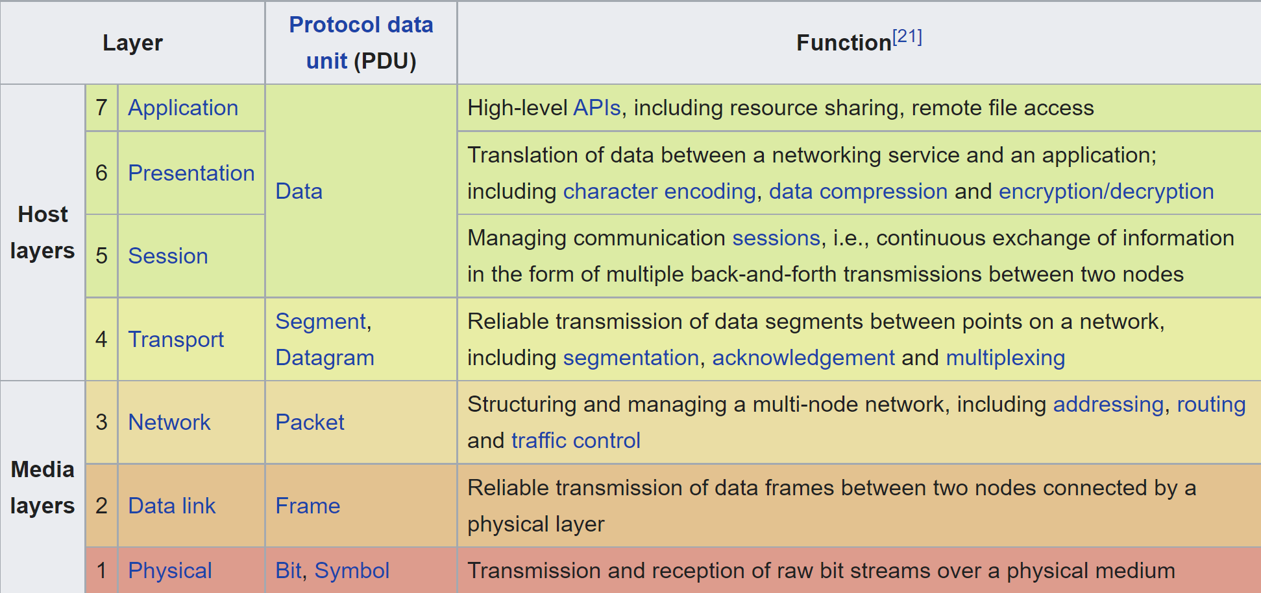
Introduction
Open Systems Interconnection model (OSI model):
7 Layers
ISO/IEC 7498 a.k.a ITU-T Recommendation X.200
Our main focus

Slide 8
Physical layer
Functions:
Bit synchronization: The physical layer provides the synchronization of the bits by providing a clock. This clock controls both sender and receiver
Bit rate control: The Physical layer also defines the transmission rate i.e. the number of bits sent per second.
Physical topologies: Physical layer specifies the way in which the different, devices/nodes are arranged in a network e.g. bus, star, or mesh topology.
Transmission mode: Physical layer also defines the way in which the data flows between the two connected devices.

Slide 9
Physical layer
Transmitter
Medium
Receiver
Laser/LED
Modulator
Optical Fibre
Free space
Photodiodes
Homo/heterodyne detectors
Parts:
Topics of interest:
Encoding data
Modulation Schemes
Security of information
Transmitter properties
Losses
Propagation errors
Amplifiers
Resource optimisation
Noise
De-modulation
Power budget

Slide 10
The basics
All data is binary: i.e. 0s and 1s
Which layer translates between binary and human readable form?
Bit: Each 0 or 1 is a bit abbreviation b
Byte: 8 bits = 1 byte abbreviation B
Kilobyte: 1024 bytes abbreviation KB
Kilobit: 10³ bits abbreviation Kb
Megabyte: 1024 KB abbreviation MB
Megabit: 10⁶ bits abbreviation Mb
Kilo
Mega
Giga
Tera
Peta
Exa
Zetta

Slide 11
Security
Encryption
Authentication
Reliability
Prevent others from reading your data
Ensure that you communicate with the right person/device
Make sure your message actually reaches

Slide 12



Basic encryption
Alice encrypts
Bob decrypts.
Eve should not know anything.

Slide 13

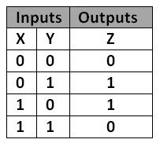
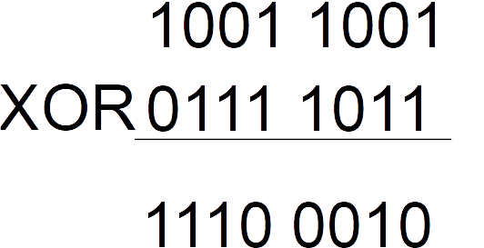
Basic encryption
Encryption needs a key (password)
11100010
10011001
01111011
The XOR operation
Random key
Message
Key
Encrypted
10011001
Eve gets randomness
Key
Message

Slide 14
Security
The problem is now distributing the key
Use mathematical problems like Prime factorisation
Which layers does encryption happen?
Hint TLS and SSL are the most commonly used protocols.

Slide 15
Security
The problem is now distributing the key
Use mathematical problems like Prime factorisation
Which layers does encryption happen?
Hint TLS and SSL are the most commonly used protocols.
Applications typically treat TLS as if it were running in the transport layer
But requires handshake so it also needs the presentation layer
SSL Deprecated in 2015
TLS currently ver 1.3
Algorithm based security protocols have limited lifetime
Handshake: a signal between devices for coordination. Typically used to enquire and confirm connection/signal status

Slide 16
Compression
Data on networks is almost always compressed.
Compression: Identify patterns in data and save the patterns rather than the raw data to reduce number of bits.
We focus on the physical layer and thus do not care about the meaning of the binary data.

Slide 17
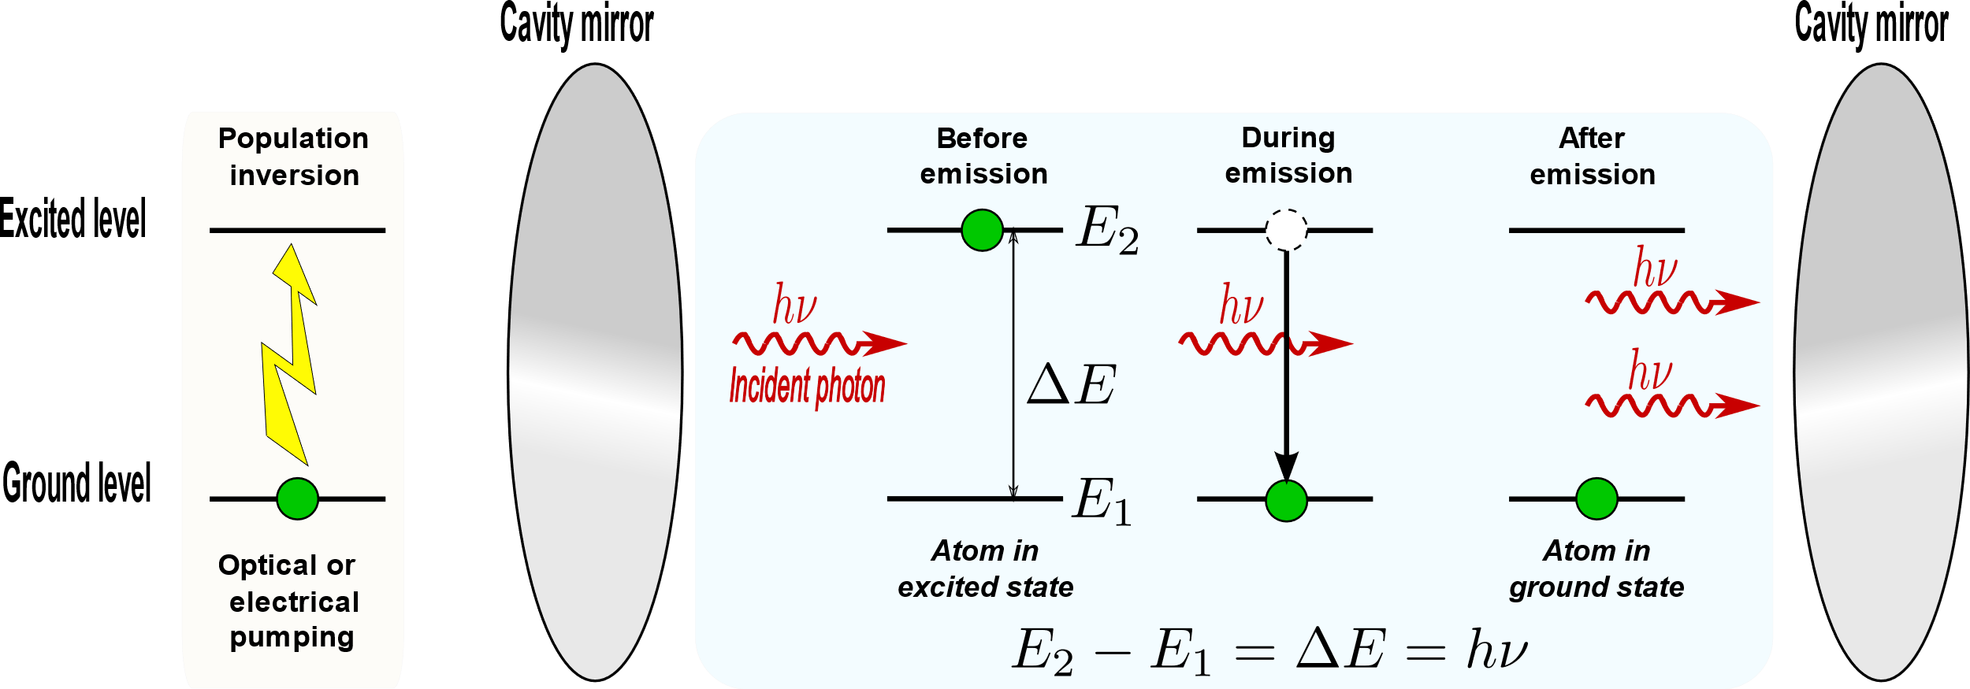
Recap: What is a laser?
Balance between Spontaneous emission, absorption & induced emission Phase coherent output.
Wavelength linewidth depends on cavity, gain medium & output power
More in Week13 Lecture003_Async

Slide 18
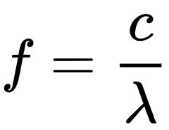
Wavelength Vs Frequency
Frequency f [Units Hz] {E.g. THz, GHz, MHz, KHz, mHz, etc}
Wavelength (lambda) λ [Units m] {E.g. nm, micron or μm or um}a
Speed of light in vacuum c
c = 299 792 458 m/s
We will always use the approximate value of c = 3E8 (3*10⁸)
Conversion between f and λ is an ILO
What is the frequency of 1550.12 nm in THz?

Slide 19
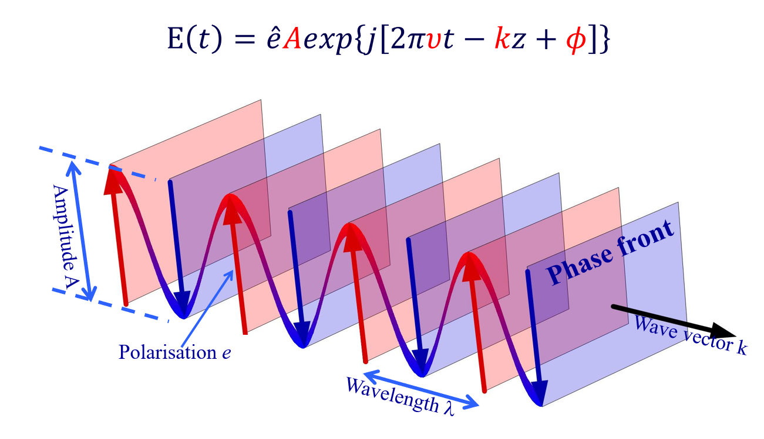
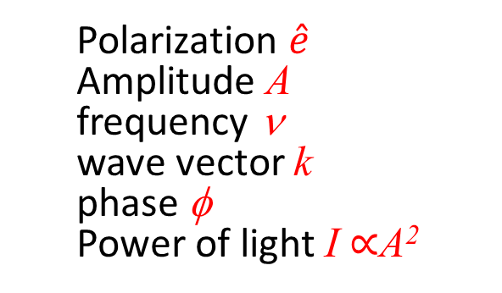
Light as a wave
Polarization $\hat{e}$
Amplitude A
frequency ν
wave vector k
phase φ
Power of light I ∝A²

Slide 20
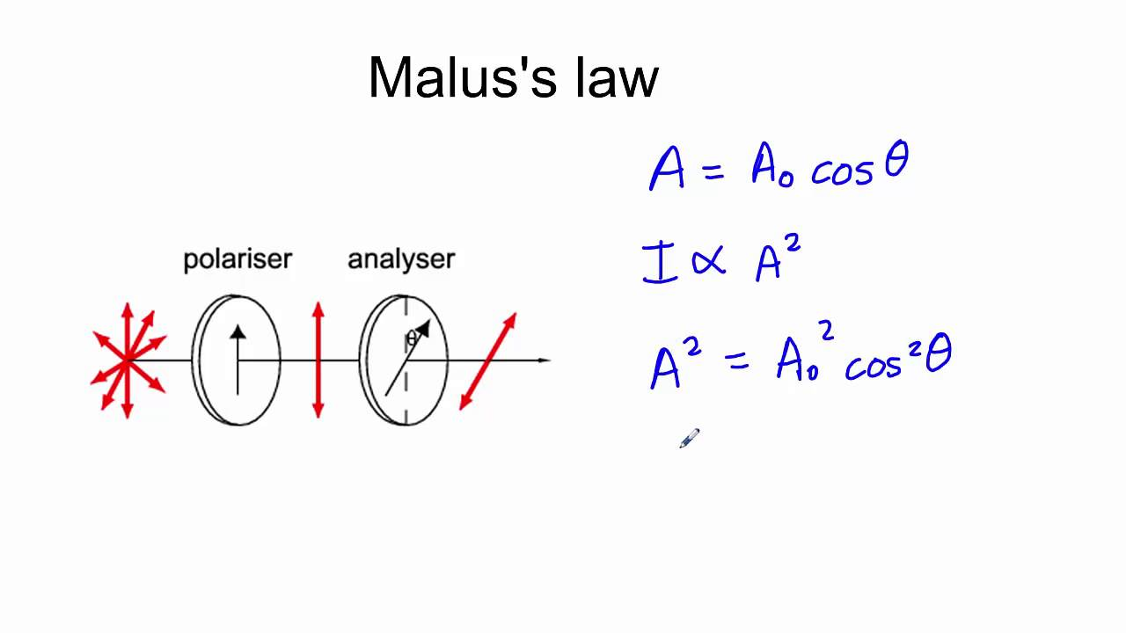
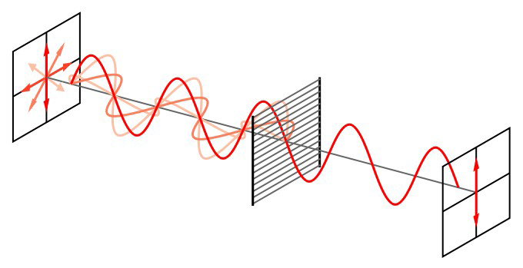
Polarisation
Direction of oscillation of Electric field.
When passing through a polarizer:
Malus’s Law
Another ILO

Slide 21
Polarisation
Direction of oscillation of Electric field.
When passing through a polarizer: Malus’s Law
Can oscillate in any plane
∣L〉
∣R〉
∣H 〉
∣V 〉
∣D〉
∣A〉
Left and Right handed
Circularly polarized
Horizontal
Vertical
Diagonal
Anti-diagonal

Slide 22
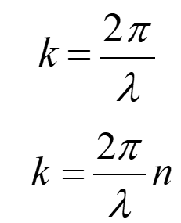
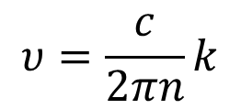
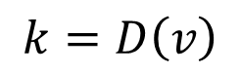
Wave number/vector
k is the number of 2π phase shifts per unit propagation distance
Wave vector (wave number) in vacuum
Wave vector (wave number) in a medium with refractive index n
Wavenumber k is not an independent parameter
Wave vector in a homogeneous medium with refractive index n
$$υ=\frac{c}{2πn}k$$
Dispersion relation
More about dispersion in Week 16
Wave vector in a waveguide (or other media with boundary conditions)
$$k=D\left(v\right)$$

Slide 23
Modulation
ILOs
Understand various modulation formats used in optical communications
Learn various methods and devices for realising optical modulation

Slide 24
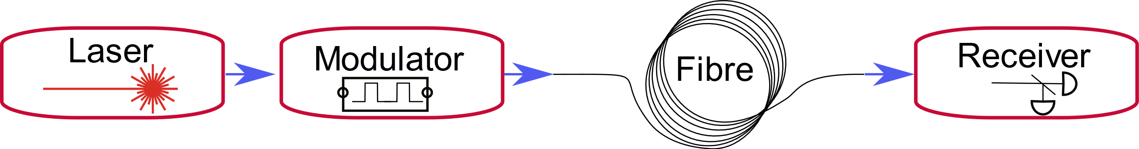
Modulation
Types:
Amplitude
Phase
Sub-Types:
On Off Keying (OOK), Amplitude Shift Keying (ASK)
Phase Shift Keying (PSK)
Both can be upgraded to Quadrature (Q) : QPSK, QAM

Slide 25
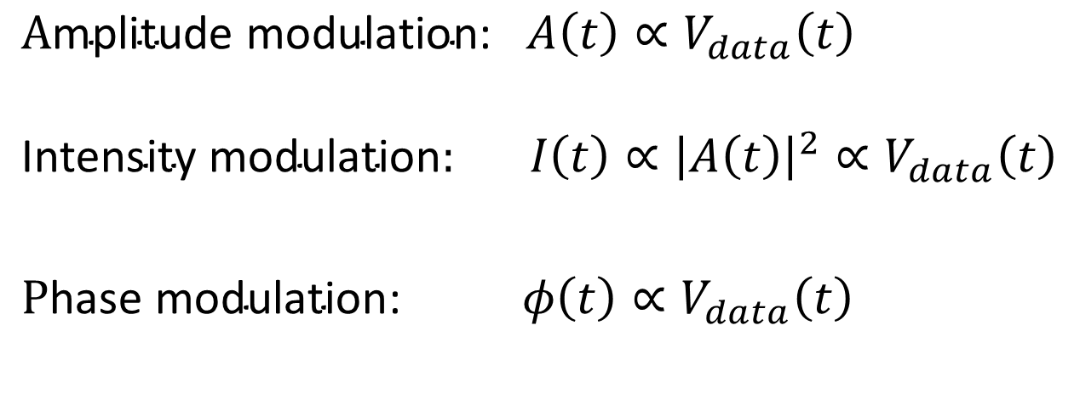
Modulation
$$\text{A}\text{mplitude} \text{modulation}\text{: }A\left(t\right)∝V_{data}\left(t\right)$$
$$\text{Intensity} \text{modulation}: I\left(t\right)∝{\left|A\left(t\right)\right|}^{2}∝V_{data}\left(t\right)$$
$\text{P}\text{hase} \text{modulation}$:$φ\left(t\right)∝V_{data}\left(t\right)$

Slide 26
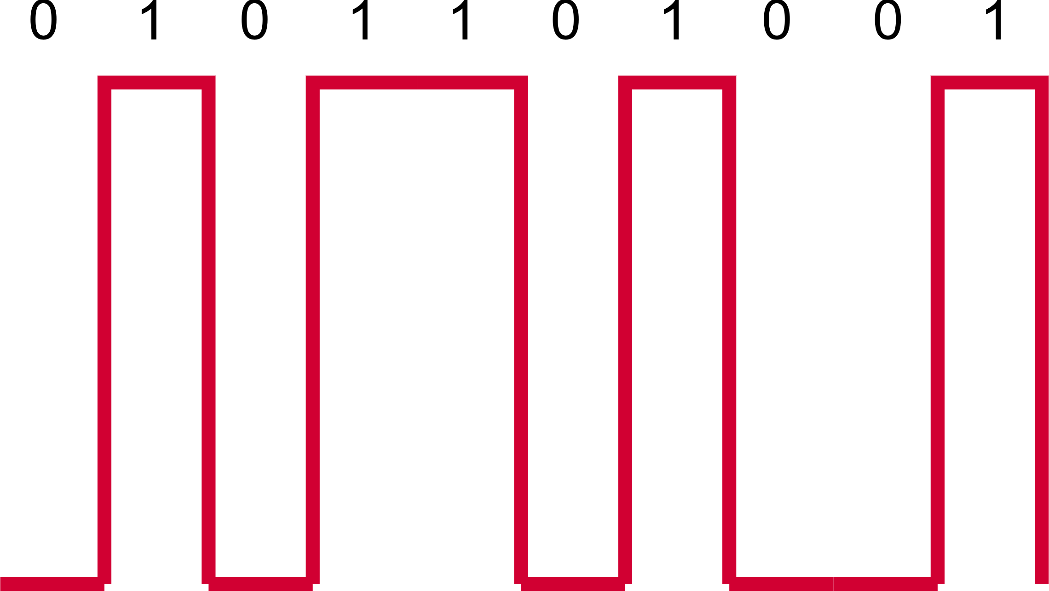
OOK
Very simple
Amplitude modulation
Cheap transmitter and receiver
Requires clock synchronisation
SNR degrades with loss

Slide 27
OOK
Direct modulation of laser
Or
External amplitude modulator
OOK is also called Binary Amplitude Modulation

Slide 28
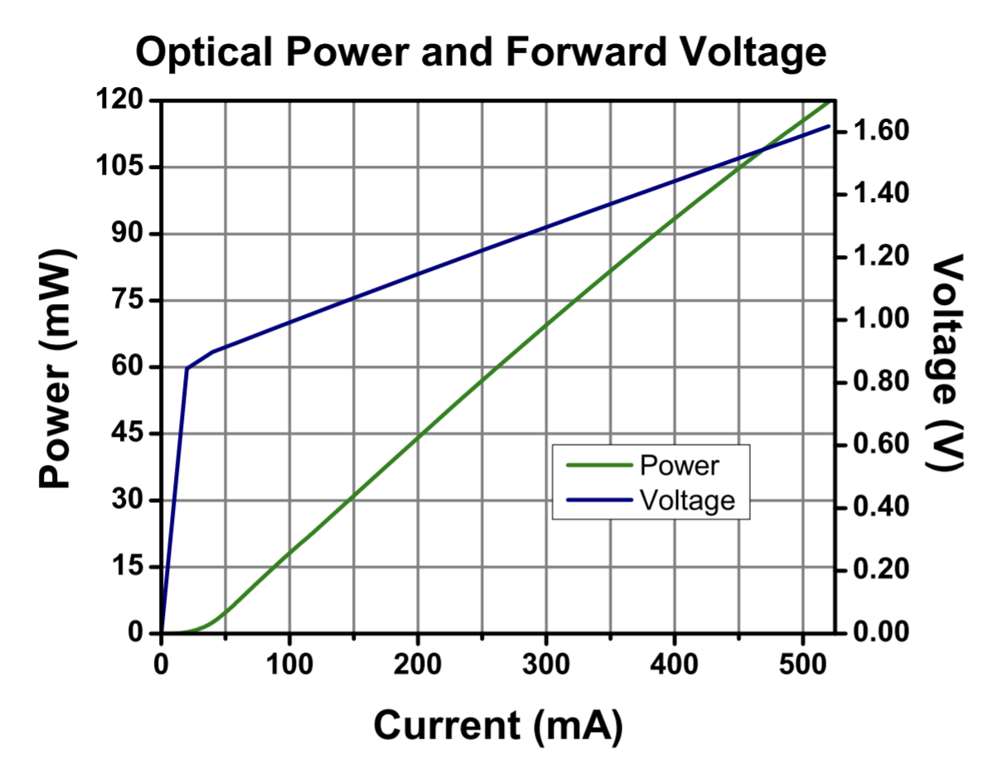
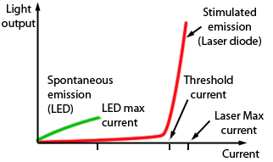
Recap: Laser threshold
FPL1009s datasheet

Slide 29
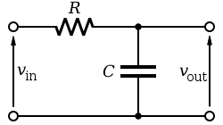
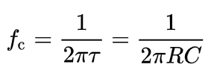
Direct modulation for OOK
Laser diode operated by a current source
Off state: Just below threshold
On state: Operating current
Using an off state of 0 mA is slower and more energy consuming
Max modulation bandwidth given by Capacitance (C), Inductance (L) and Resistance (R). Which form a filter.
Simplest low pass filter.
Cut off frequency (-3dB) is

Slide 30
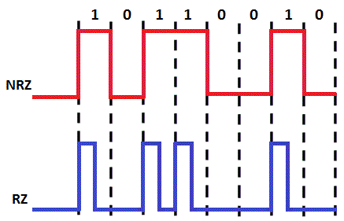
OOK formats
NRZ: Non Return to Zero. Pulse representing 1 stays in the high state for the entire clock cycle.
RZ: Return to Zero. The 1 pulse returns to the zero state within the clock cycle.
NRZ has narrower spectral bandwidth
RZ can have better performance at high data speed, and easier for clock recovery
Why is this?
T
τ₁

Slide 31
OOK formats
Average transmitted power
Small p: probability of 0 or 1
is the duty cycle
D=1: NRZ code
D~0.3 – 0.5 for RZ code
Duty Cycle
Typically we have equal number of 0s and 1s
Because of the usually non-zero values of P₀, the light is not completely ‘Extinct’.

Slide 32
OOK formats
‘Extinction Ratio’ is defined as
Optical modulation
amplitude is defined as
general
(NRZ)
Prove this statement and derive the equivalent for RZ
Do not confuse OMA with OAM Optical Amplitude Modulator is a device
OMA is the actually useful signal amplitude

Slide 33
OOK Direct modulation of a LD
Optical
power
Slope efficiency
η=dP/dI
P₁
P_{t}
P₀
I_{th}
I_{b}
current
I_{data}

Slide 34
OOK Direct modulation of a LD
LDs have limited modulation response bandwidth
BW
Response of output optical power
f_{r}
f_{3dB}
Frequency of electrical current
It’s frequency response typically exhibits a 2nd order filter response
a resonance peak fr
3dB BW of up to 20-30 GHz can be achieved with carefully engineered LDs
Height of peak should be controlled
Max 3dB BW is obtained at ‘critical damping’

Slide 35
OOK Direct modulation of a LD
Ideal current waveform
BW limited output waveform
Under-damped output waveform
Pulse
waveform
More about eye diagrams tomorrow
Eye diagram
Waveform distortion caused by
BW limitation: slow rising and falling edges
Relaxation osc.: resulting in thick ‘eye-lid’ in eye-diagram

Slide 36
OOK Direct modulation of a LD
Low cost😀
Low waveform quality😢
Low spectral quality😢
Can only be used for short-reach optical communications links

Slide 37
Using external modulators
We will discuss how modulators are used in the Asynchronous Lecture Week13_Lecture_011_Async_Modulators
This will draw on knowledge form optoelectronic devices and other courses.

Slide 38
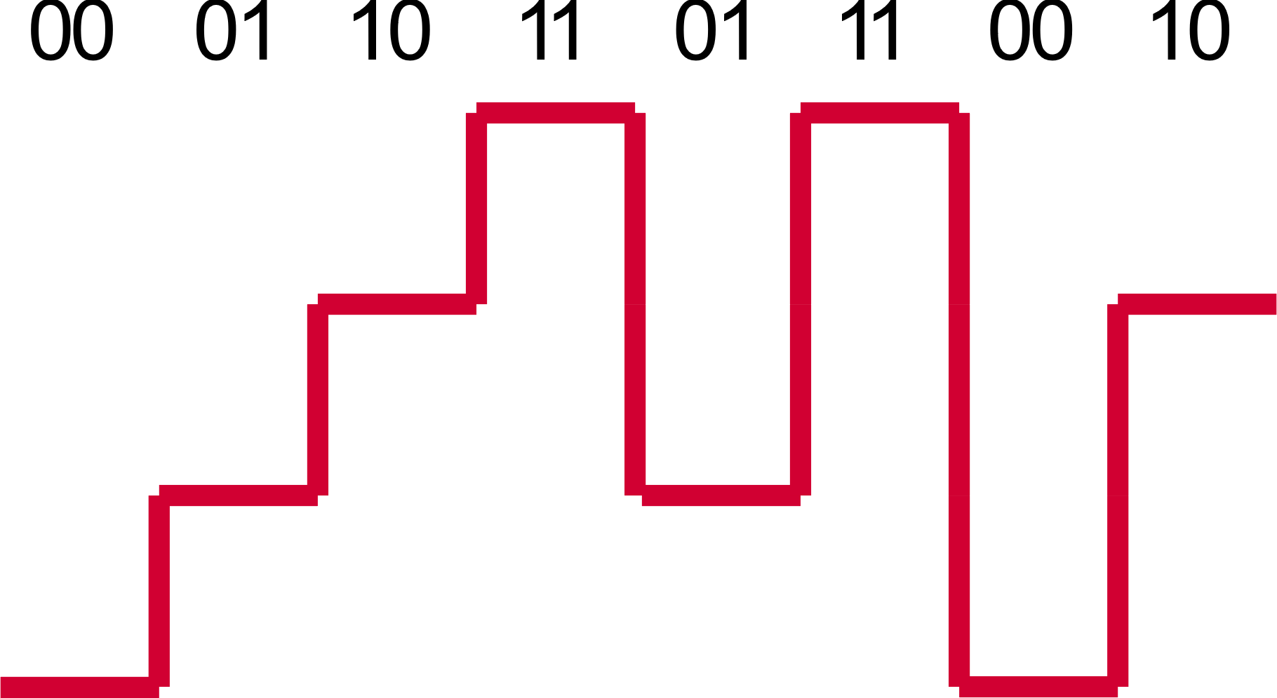
ASK
Each amplitude level represents one symbol
Better than OOK
Simple receiver
Baud rate = number of symbols (L) per second
Data rate = Baud rate * log₂(L)
We will calculate this error rate when we study demodulation and receivers
Increased error probability (lower SNR)

Slide 39
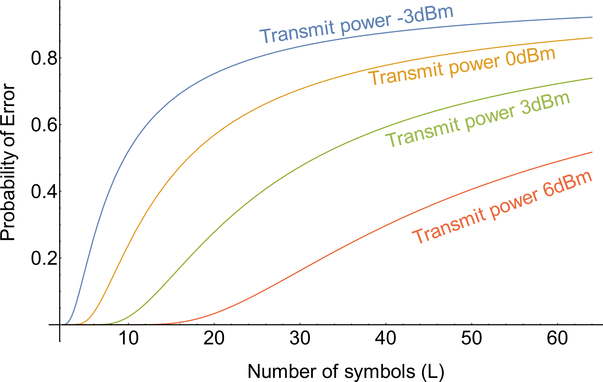
ASK
4 symbols is typically a good choice
You will learn how to calculate this soon
Graph calculated with common values of detection noise & loss. Assuming no intersymbol interference.

Slide 40
ASK
What laser do we need?
High carrier frequencies (either modulated lasers or high repetition rate pulsed lasers)
Where is it used?
Ethernet protocols (E.g., EEE 802.3ba 100Gb/s & IEEE P802.3bs 400Gb/s standards)
<10 Km or <40 Km links
≈ up to 25 GBd (Giga baud)

Slide 41
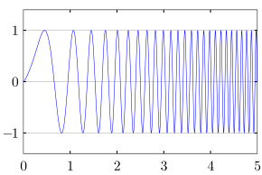
Frequency Chirp
Frequency chirp: Rapid change in (modulation) frequency
Two types:
Change in modulation: due to imperfect shape of electric pulse.
Change in wavelength: due to refractive index dependence of a semiconductor on the current flowing through it. This changes the optical path length of the laser cavity.
Also called parasitic phase modulation

Slide 42
Frequency Chirp
Input current waveform
freq
Output power waveform
t
Output frequency chirp
Chirp: optical frequency change accompanying amplitude change
In direct modulation, Chirp is caused by current change, as n is function of current I
Typical value dν / dI ~ 120GHz/mA
Chirp broadens the optical spectrum
Chirp is bad for transmission because of fibre dispersion (discussed later)
This chirp happens to all lasers: even DFB laser will have chirp under direct modulation

Slide 43
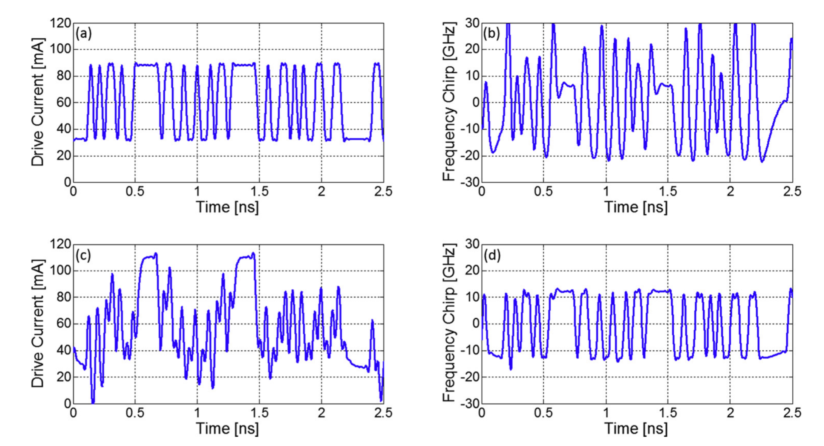
Frequency Chirp
Fix frequency chirp by modulating laser drive current
Complex fix
Strong limit on baud rate if not fixed.
A. S. Karar, et al. Optik, 206, 164308 (2020).

Slide 44
Signal spectra
Spectrum before modulation
Spectrum is a δ−function
BW
BW
Optical frequency
Optical frequency
Optical frequency
Spectrum after
NRZ modulation
BW = 2x (1/T)
Pure amplitude modulation will create symmetric side-bands
The modulated signal BW is decided by the pulse width τ: BW∝ 1/τ₁
NRZ: τ₁=T, (T: data clock period)， RZ: τ₁<T
Spectrum after
RZ modulation
BW = 2x (1/τ₁)

Slide 45
Signal spectra
Spectrum before modulation
Spectrum is a δ−function
BW
BW
Spectrum after
NRZ modulation
No chirp
Spectrum after
NRZ modulation
With chirp
Additional phase modulation (PM) or chirp will
Broaden the spectrum of AM signals
Make the spectrum asymmetric

Slide 46
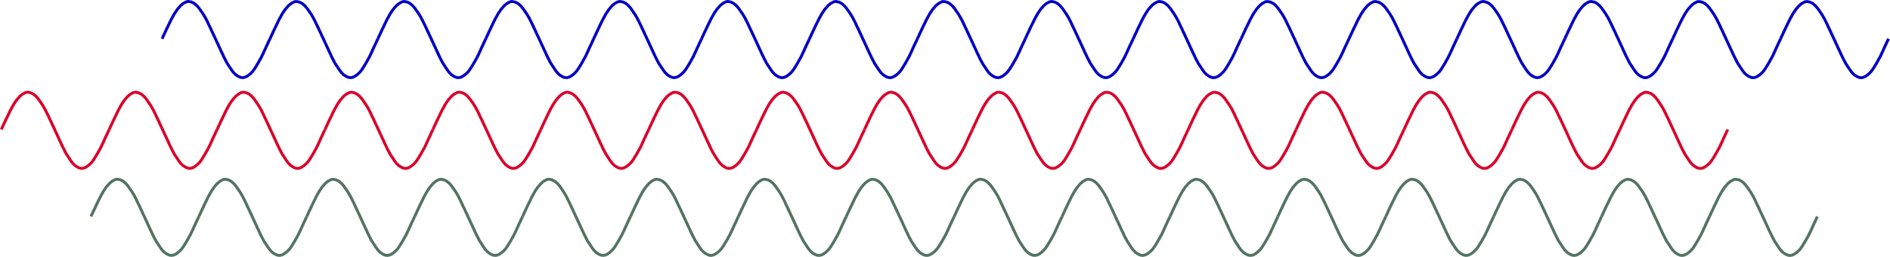
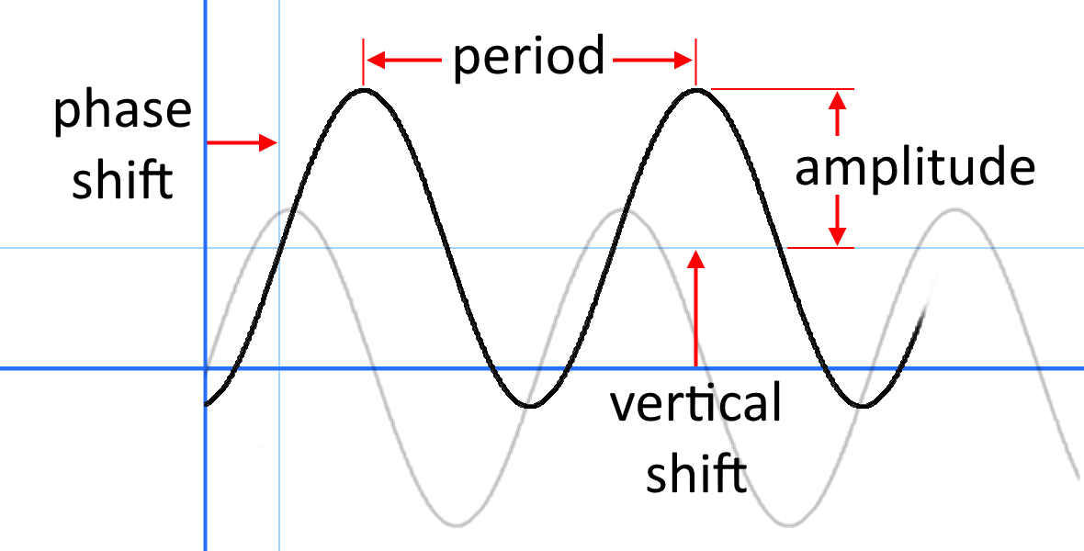
Phase
0 degree
180 deg or π
90 deg or π/2
Phase is always a relative measurement.

Slide 47
Phase coherence
A laser is phase coherent.
i.e. all light emitted from the laser at the same time has the same phase.
A laser’s phase drifts with time.
Phase measured by interference

Slide 48
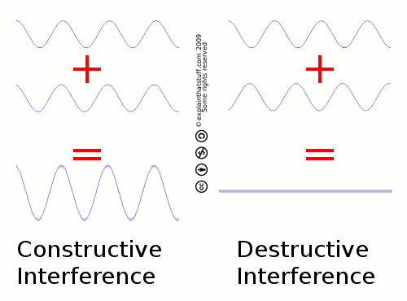
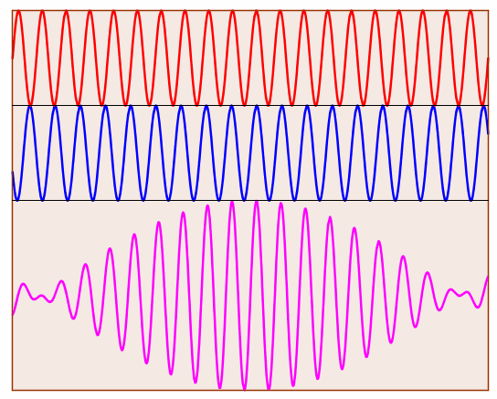
Interference
Light of same frequency and same polarisation can interfere.
Interference is the sum of the wave equations.
Light of different frequencies can interfere to give a beat frequency
Beat frequency is the envelope
= |f₁ – f₂|
https://ophysics.com/waves10.html

Slide 49
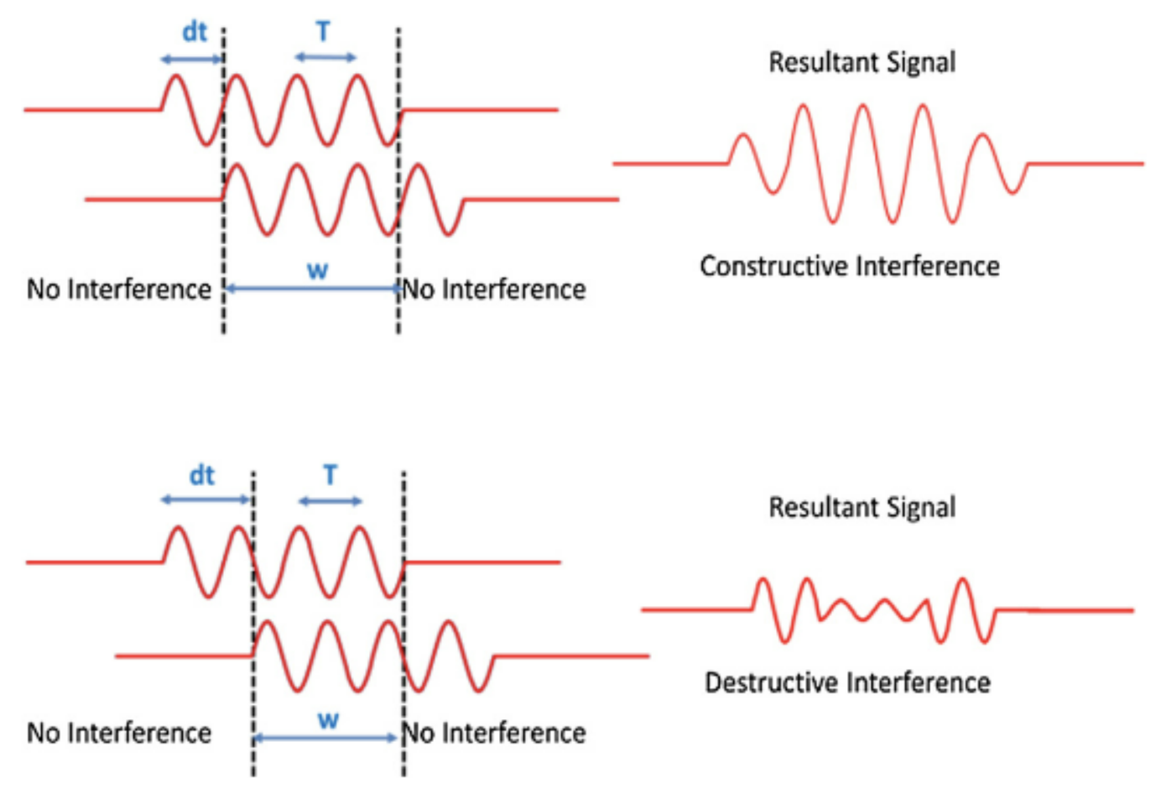
Interference
Phase changes can be detected by interference.
Interfere a reference signal and the phase modulated signal to detect phase changes.

Slide 50
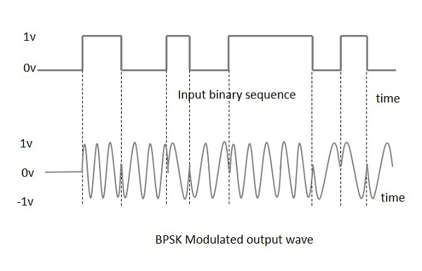
PSK
Amplitude is affected by noise and loss.
Phase of carrier wave less so.
Binary PSK L = 2 (0 0°, 1 180°)
Less sensitive to noise
Good for long distance and lossy links
Complex signal reconstruction Needs a local oscillator at carrier frequency.
Can you think of this before we discuss it in Week 15?

Slide 51
Problem
Convert a frequency difference of 100 GHz at 1550nm to the corresponding wavelength difference. State your answer in nm.
Hint: Frequency difference is f₁ – f₂ and is not the same as 100 GHz directly expressed in nm.

Slide 52
Problem
A BAM scheme uses a signal amplitude of 0dBm for 1 and -10dBm for 0. With a duty cycle of 1. Calculate the average transmitted power.
With a time period of 1ns what is the frequency bandwidth of the modulator required?
If the duty cycle was 0.2 what would be the new average power and the new frequency bandwidth required for the modulator?
Explain the difference between the frequency bandwidth of the modulator and the optical bandwidth of the transmitted signal.

